Slide 1
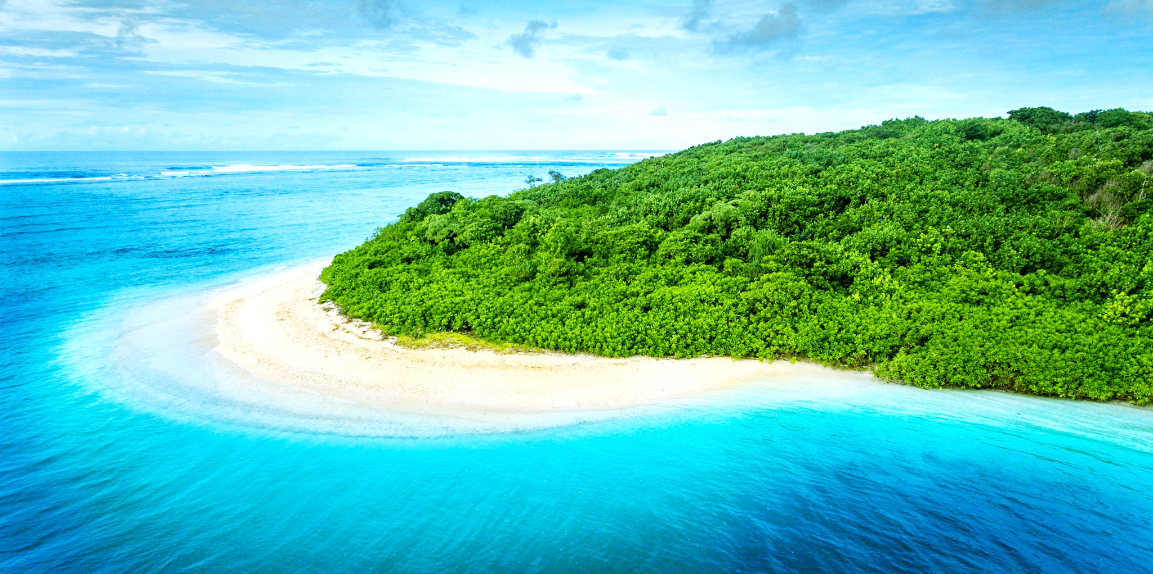

The Enggano Language
Nothofer’s contribution to solving a linguistic puzzle
17 Dec 2021
Daniel Krauße, M.A.
University of Newcastle
Towards the next 40 years of Southeast Asian Studies in Frankfurt — Symposium in honour of Prof. Bernd Nothofer

Slide 2
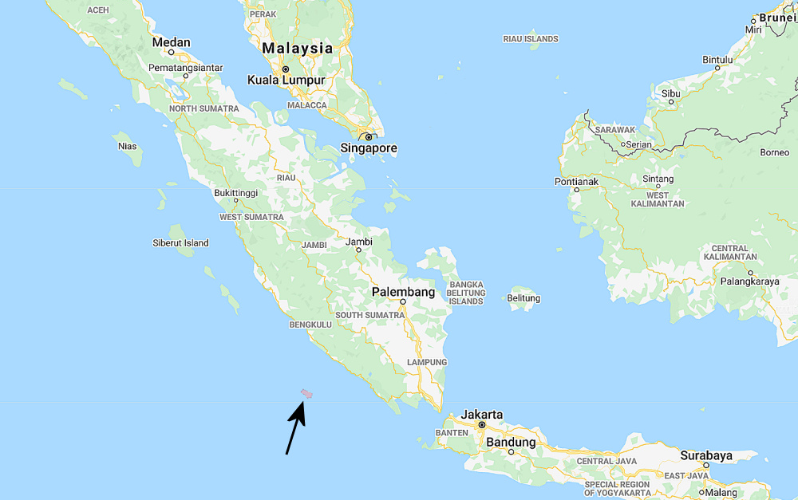
What is Enggano?
Enggano is a language spoken on Enggano Island, situated about 130 kilometers off the southern coast of Sumatra in Indonesia. It is about 35 km long. Less than 2,000 people speak Enggano.

Slide 3
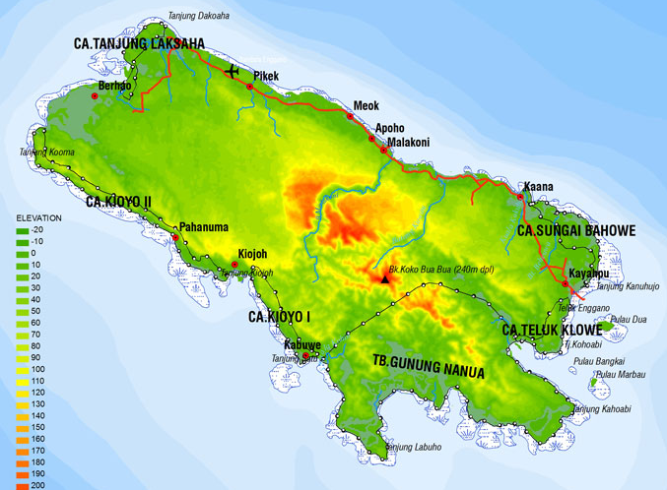
What is Enggano?
Enggano is a language spoken on Enggano Island, situated about 130 kilometers off the southern coast of Sumatra in Indonesia. It is about 35 km long. Less than 2,000 people speak Enggano.

Slide 4
What is the puzzle?
“But Enggano […] is a remnant of these pre-Austronesian languages, which does indeed have Austronesian loanwords, but which remains non-Austronesian.
Capell (1982:6)

Slide 5
What is the puzzle?
“But Enggano […] is a remnant of these pre-Austronesian languages, which does indeed have Austronesian loanwords, but which remains non-Austronesian.
Capell (1982:6)
“Enggano most likely belongs to the Western Malayo-Polynesian branch of the Austronesian languages, but it exhibits only very few lexical correspondences with other Austronesian languages.”
Kähler’s dictionary (1987:iii), edited by Hans Schmidt

Slide 6
What is the puzzle?
“But Enggano […] is a remnant of these pre-Austronesian languages, which does indeed have Austronesian loanwords, but which remains non-Austronesian.
Capell (1982:6)
“Enggano most likely belongs to the Western Malayo-Polynesian branch of the Austronesian languages, but it exhibits only very few lexical correspondences with other Austronesian languages.”
Kähler’s dictionary (1987:iii), edited by Hans Schmidt
“For linguists, Enggano is an intriguing puzzle: it has been claimed by some linguists to be a member of the Austronesian language family, like many other languages of the region, but by other linguists to be an isolate with no known relation to other languages.”
(Project website 2019-2021: Enggano in the Austronesian family: Historical and typological perspectives)

Slide 7
What is the puzzle?
“But Enggano […] is a remnant of these pre-Austronesian languages, which does indeed have Austronesian loanwords, but which remains non-Austronesian.
Capell (1982:6)
“Enggano most likely belongs to the Western Malayo-Polynesian branch of the Austronesian languages, but it exhibits only very few lexical correspondences with other Austronesian languages.”
Kähler’s dictionary (1987:iii), edited by Hans Schmidt
“For linguists, Enggano is an intriguing puzzle: it has been claimed by some linguists to be a member of the Austronesian language family, like many other languages of the region, but by other linguists to be an isolate with no known relation to other languages.”
(Project website 2019-2021: Enggano in the Austronesian family: Historical and typological perspectives)
“Enggano is a puzzle within Austronesian linguistics.”
(Butters 2021:25)

Slide 8
What is the puzzle?
Linguists try to classify all languages according to their genetic affiliation (e.g. English is Indo-European, Indonesian is Austronesian, Chinese is Sino-Tibetan, etc.).
This is done through a careful analysis of the lexicon, phonology and morphology.
Common words in (supposedly) related languages are reconstructed.

Slide 9
What is the puzzle?
Linguists try to classify all languages according to their genetic affiliation (e.g. English is Indo-European, Indonesian is Austronesian, Chinese is Sino-Tibetan, etc.).
This is done through a careful analysis of the lexicon, phonology and morphology.
Common words in (supposedly) related languages are reconstructed.
English | Russian | Hindi | Indo-European
six | šestʹ “six” | chah “six” | *swéḱs
mouse | myšʹ “mouse” | mūs “mouse” | *múh₂s
bear (v.) | brémja “burden” | bharna “to fill” | *bʰer-
snow | sneg “snow” | sneh “affection” | *snóygʷʰos

Slide 10
What is the puzzle?
Linguists try to classify all languages according to their genetic affiliation (e.g. English is Indo-European, Indonesian is Austronesian, Chinese is Sino-Tibetan, etc.).
This is done through a careful analysis of the lexicon, phonology and morphology.
Common words in (supposedly) related languages are reconstructed.
English | Russian | Hindi | Indo-European
six | šestʹ “six” | chah “six” | *swéḱs
mouse | myšʹ “mouse” | mūs “mouse” | *múh₂s
bear (v.) | brémja “burden” | bharna “to fill” | *bʰer-
snow | sneg “snow” | sneh “affection” | *snóygʷʰos
Indonesian | Fijian | Enggano¹ | Austronesian
lima “five” | lima | aʹri:b̚ | *lima
telinga “ear” | daliga | kariç | *Caliŋa
batu “stone” | vatu | ɛ | *batux
dengar “hear” | roŋo | kidəʹhə: | *dəŋəR
These words are taken from Nothofer’s list (1986).

Slide 11
What is the puzzle?
Linguists try to classify all languages according to their genetic affiliation (e.g. English is Indo-European, Indonesian is Austronesian, Chinese is Sino-Tibetan, etc.).
This is done through a careful analysis of the lexicon, phonology and morphology.
Common words in (supposedly) related languages are reconstructed.
English | Russian | Hindi | Indo-European
six | šestʹ “six” | chah “six” | *swéḱs
mouse | myšʹ “mouse” | mūs “mouse” | *múh₂s
bear (v.) | brémja “burden” | bharna “to fill” | *bʰer-
snow | sneg “snow” | sneh “affection” | *snóygʷʰos
Indonesian | Fijian | Enggano¹ | Austronesian
lima “five” | lima | aʹri:b̚ | *lima
telinga “ear” | daliga | kariç | *Caliŋa
batu “stone” | vatu | ɛ | *batux
dengar “hear” | roŋo | kidəʹhə: | *dəŋəR
These words are taken from Nothofer’s list (1986).

Slide 12
What is the puzzle?
The real puzzle is that, for a long time, linguists haven’t been able to determine which language family Enggano belongs to.
Rosenberg (1878:217) argues for Enggano that “the language does not have the slightest resemblance with the idioms of the neighboring peoples, it is very poor in words, inharmonious and harsh”.
Modigliani (1894) compared the Enggano people to the Nicobarese (Austroasiatic language family).
For Lafeber (1922:24), the previous wordlists are insufficient to determine whether or not Enggano is a Malayo-Polynesian language.
Kähler (1942/45:890) hypothesizes that Enggano is a “mixed” language of the original language and Sulawesi languages.
Dyen (1965:53) uses lexicostatistics and counts a maximum of only 11% retention of Austronesian vocabulary, which is too low to state that it is indeed Austronesian.

Slide 13
What is the puzzle?
Capell (1982) states that Enggano is a “remnant of these pre-Austronesian languages, which does indeed have Austronesian loanwords, but which remains non-Austronesian”.
Nothofer (1986) uses qualitative evidence to establish regular sound changes for Enggano.
Schmidt (1988) builds on Nothofer’s material and agrees with Nothofer.
Blench (2014) circulates a draft for comment and hypothesizes that “Engganese is underlyingly a forager language of unknown affiliation but presumably a descendant of the original language spoken by Pleistocene settlers.”
Edwards (2015) and Smith (2017) confirm the regular sound changes established by Nothofer
The most recent version of Ethnologue (Eberhard, Gary & Fennig 2021) lists Enggano as “unclassified”.
Is Enggano an Austronesian language or is it not?

Slide 14
Nothofer’s contibution
In 1982 and 1984, Bernd Nothofer stayed six weeks in a longhouse on Siberut, Mentawai Islands and did fieldwork which was partially funded by the Volkswagen Foundation.
In 1984, the “4th International Conference on Austronesian Linguistics” took place in Suva, Fiji. Nothofer presented a paper entitled The Barrier Island Languages in the Austronesian Language Family in which he demonstrated regular sound correspondences between the languages belonging to a Barrier Island-Batak subgroup (Simalur, Sichule, Nias, Mentawai, Enggano, Toba-Batak).
He drew on previously published material for Enggano, Nias, Sichule, Simalur and Mentawai and added to this his own fieldwork material on Mentawai.
An article of his talk was published in 1986 in “FOCAL II: papers from the Fourth International Conference on Austronesian Linguistics”.
What did he do?

Slide 15
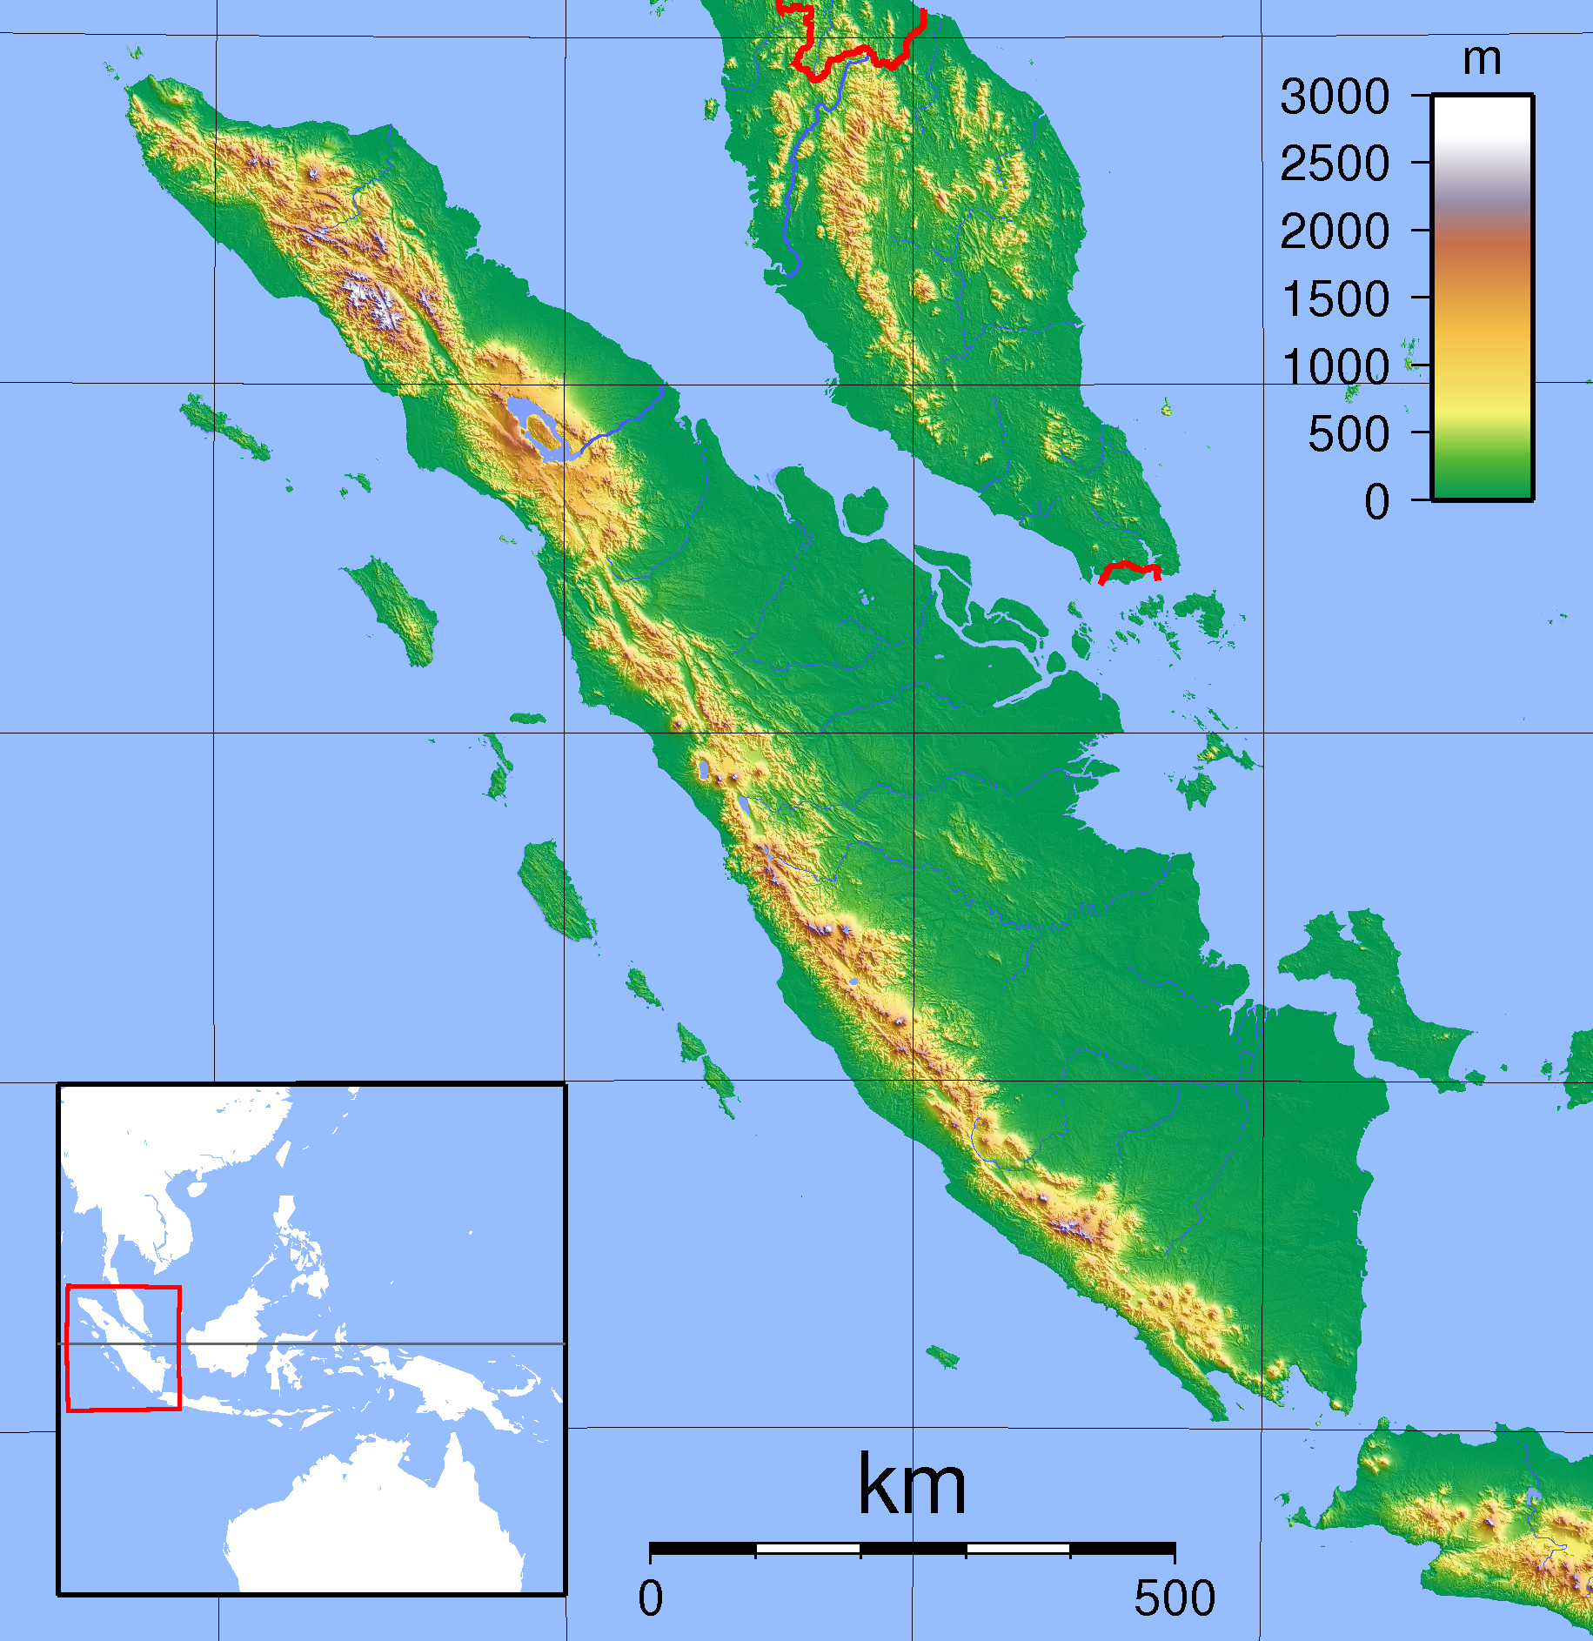
Nothofer’s contibution

Slide 16
Nothofer’s contibution
Sichule
Simalur
Nias
Mentawai
Enggano

Slide 17
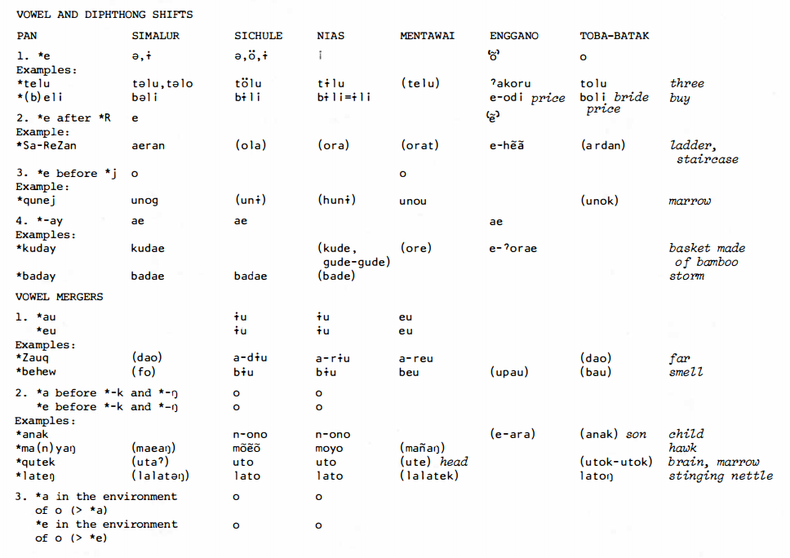
Nothofer’s contibution

Slide 18
Nothofer’s contibution

Slide 19
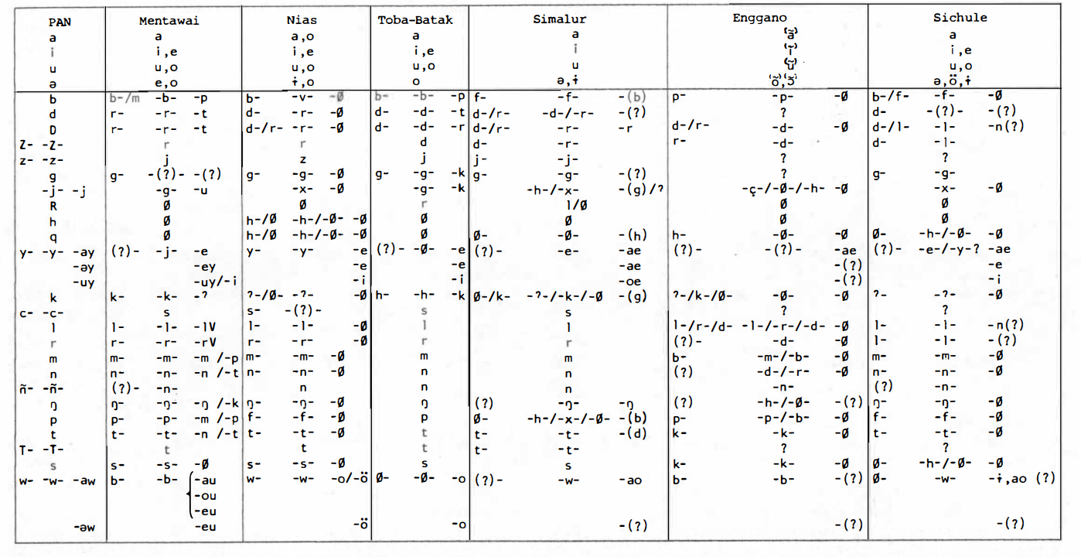
Nothofer’s contibution

Slide 20
Nothofer’s contibution
He discovered that Enggano has unusual sound changes for an Austronesian language:
*/t/ > /k/ PAN *telu > ʔa-koru “three” (also */e/ > /o/ and */l/ > /r/)
*/s/ > /k/ PAN *sijem > e-kiço “ant” (also */e/ > /o/ and *C# > Ø/)
*/ŋ/ > /h/ (no example given)
*/d/ > /r/ PAN *kuday > ʔe-orae “bamboo basket” (also */d/ > /r/)
*/j/, */R/, */h/, */q/, */k/ > Ø PAN *Rumaq > e-uba “house” (also */m/ > /b/)
*C# > Ø PAN *xe(m)pat > a-opa “four”
*/d/, */Z/, */g/, */y/, */c/, */T/ > ??? PAN *Sa-ReZan > e-hẽã “staircase”
Such a discovery is the jackpot in historical linguistics! But the correspondences couldn’t be backed up with many examples (later criticized by Blench 2014).

Slide 21

Nothofer’s contibution
In early 1986, Bernd Nothofer (BN) went to Sumatra again and conducted interviews with 28yo Hamdani Ka’uno (HK) who was a native speaker of Enggano residing in Padang, funded by the DAAD.
BN: 24 Januari 86 Padang, bahasa Enggano, hari pertama. Baik, kalau ‘satu’ apa dalam bahasa Enggano?
HK: Kahai.
BN: Kita memajukan ini saja. Baik, kalau ‘satu’ apa dalam bahasa Enggano?
HK: Kahai … kahai.
BN: Sekali lagi.
HK: Kahai, kahai.
BN: Nah itu? Gampang? Sulit? Terus nomor dua?
HK: Aruu.
BN: Sekali lagi.
HK: Aruu.
Listen
Within three months, about 3500 Enggano words were collected!
But what to do with these words?

Slide 22
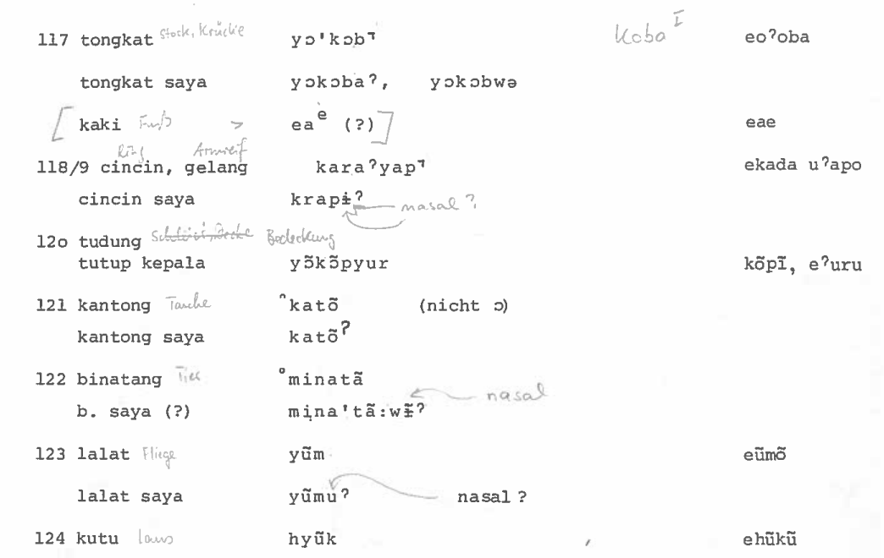
Nothofer’s contibution

Slide 23
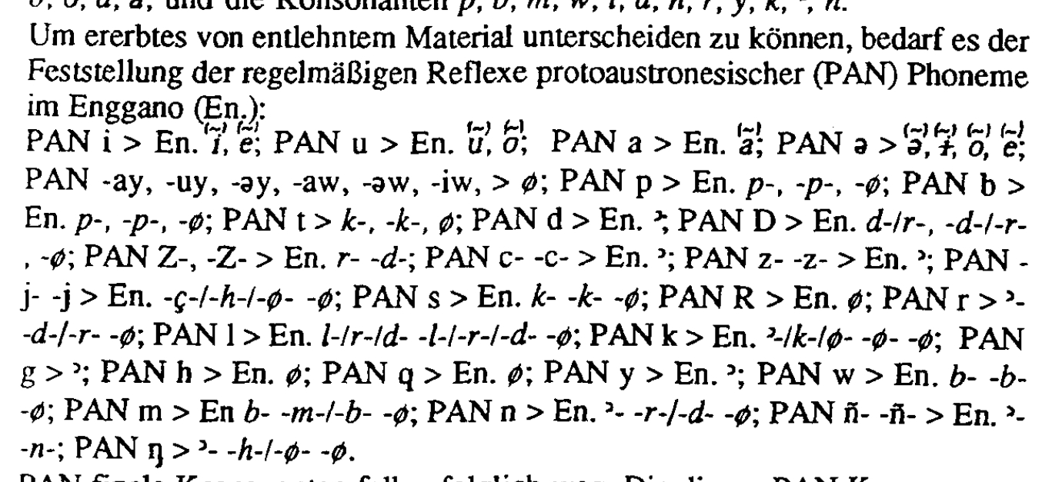
Nothofer’s contibution
In 1992, Nothofer published a German article on loanwords in Enggano.
First, he repeats his proposed sound laws:

Slide 24
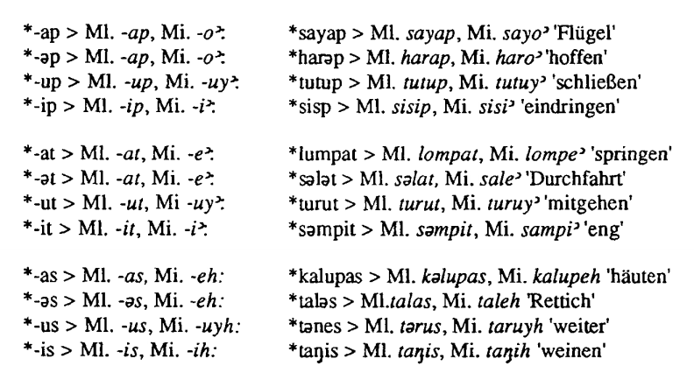
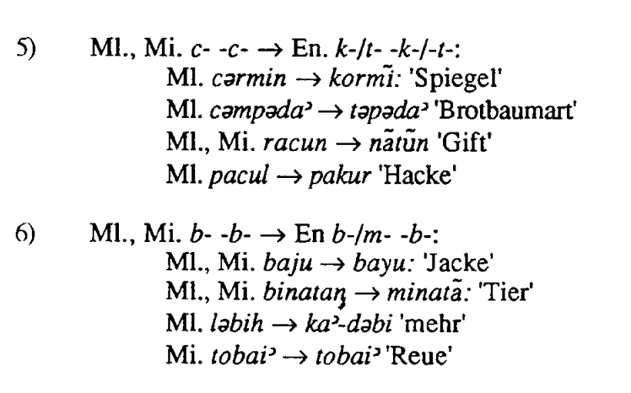
Nothofer’s contibution
Then he establishes regular correspondences to show whether a word was borrowed from Malay or from Minangkabau.
Finally, he demonstrates that in many cases one can decide which of the two languages Enggano borrowed from.

Slide 25
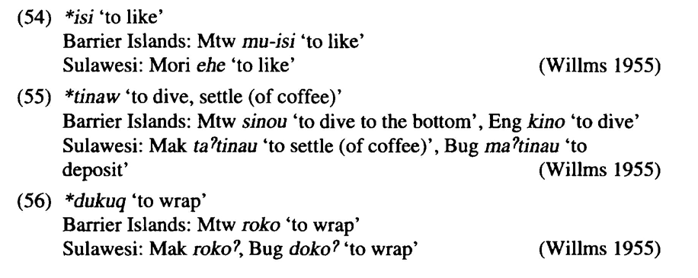
Nothofer’s contibution
In 1994, Nothofer revives an earlier hypothesis by other scholars (Kähler ms., Willms 1955, Mahdi 1988) that the Barrier Islands languages and the Sulawesi languages display a close relationship of some form (be it through borrowings or genetic affiliation).
He proposes a Paleo-Hesperonesian proto-language, which probably also includes Enggano (very litte evidence for the latter is presented).

Slide 26
Nothofer’s contibution
In 1994, Nothofer revives an earlier hypothesis by other scholars (Kähler ms., Willms 1955, Mahdi 1988) that the Barrier Islands languages and the Sulawesi languages display a close relationship of some form (be it through borrowings or genetic affiliation).
He proposes a Paleo-Hesperonesian proto-language, which probably also includes Enggano (very litte evidence for the latter is presented).

Slide 27
Nothofer’s contibution
In 1994, Nothofer revives an earlier hypothesis by other scholars (Kähler ms., Willms 1955, Mahdi 1988) that the Barrier Islands languages and the Sulawesi languages display a close relationship of some form (be it through borrowings or genetic affiliation).
He proposes a Paleo-Hesperonesian proto-language, which probably also includes Enggano (very litte evidence for the latter is presented).
In 2015, Owen Edwards provides further evidence for Nothofer’s sound correspondences. He states that “Most of these correspondences [between PMP and Enggano] have already been noted by Nothofer (1986) and Schmidt (1988:34-35).”
With the early contribution from Nothofer and the novel data from Edwards, we can now safely say that Enggano is an Austronesian language.

Slide 28
Nothofer’s contibution
In 2019, an international research project entitled “Enggano in the Austronesian family: Historical and typological perspectives” was formed at the University of Oxford with Mary Dalrymple, I Wayan Arka and Bernd Nothofer as the team’s principal investigators.
The aim of the project is to compile a new dictionary of Enggano, to write a comprehensive grammar of Enggano, and to test various hypotheses for the “aberrance” of the Enggano lexicon.
A preliminary offshoot of the project is Nothofer’s 2021 article on the history of the Enggano lexeme bakub ‘window’, which consists of bak ‘eye’ + ub ‘house’. It displays a nice introduction to the complex historical development of the Enggano sound system: bak < *maCa ‘eye’, ub < *Rumaq ‘house’
In 2021, Bernd Nothofer invited Erik Zobel and me to join the project.
We are very grateful for Nothofer’s dedication to Indonesian linguistics and to the Enggano language!

Slide 29
Nothofer’s contibution
Mėk em neah!
Terima kasih banyak!

Slide 30
References
Blench, R. ([2014]). The Enggano: Archaic foragers and their interactions with the Austronesian world. Unpublished manuscript.
Butters, Marielle (2021). Negation in Four Languages of Indonesia. PhD Thesis. Boulder: University of Colorado.
Capell, A. (1982). Bezirkssprachen im Gebiet des UAN. In Carle, R.: Gava’: Studies in Austronesian languages and cultures dedicated to Hans Kähler (pp. 1-14). Berlin: Dietrich Reimer.
Dyen, I. (1965). A Lexicostatistical Classification of the Austronesian Languages. Baltimore: Waverly Press.
Eberhard, D. M.; G. F. Simons; C. D. Fennig (eds.) (2021). Ethnologue: Languages of the World (24th ed.). Dallas: SIL International. URL: www.ethnologue.com/language/eno.
Edwards, O. (2015). The Position of Enggano within Austronesian. Oceanic Linguistics 54(1): 54-109.
Enggano in the Austronesian family: Historical and typological perspectives (2019-2021). Project at the University of Oxford.
Kähler, H. (1942/1945). Über Mischsprachen in Indonesien. Anthropos 37/40:889–90.
Kähler, H. (1987). Enggano-Deutsches Wörterbuch. Aus dem Nachlaß herausgegeben und mit einem Deutsch-Enggano-Wörterverzeichnis versehen von Hans Schmidt. Berlin, Hamburg: Dietrich Reimer.
Kähler, H. Grammatik der Simalursprache. Unpublished ms.
Lafeber, A. (1922). Vergelijkende klankleer van het Niassisch. Den Haag.
Mahdi, W. (1988). Morphologische Besonderheiten und historische Phonologie des Malagasy. Veröffentlichung des Seminars für Indonesisch und Südseesprachen der Universität Hamburg 20.
Modigliani, E. (1894). L’isola della donne: Viaggio ad Engano. Milan: Ulrico Hoepli.
Nothofer, B. (1986a). The Barrier Island languages in the Austronesian language family. In Geraghty, P., L. Carrington & S. A. Wurm: FOCAL II: Papers from the Fourth International Conference on Austronesian Linguistics (pp. 87-109). Canberra: The Australian National University.
Nothofer, B. (1986b). Enggano wordlist with Indonesian and German translations. Unpublished manuscript.
Nothofer, B. (1986c). Tape recordings of Enggano with the speaker Hamdani Ka’uno.
Nothofer, B. (1992). Lehnwörter im Enggano. In F. Schultze & K. Tauchmann (eds.): Kölner Beiträge aus Malaiologie und Ethnologie zu Ehren von Professor Dr. Irene Hilgers-Hesse (pp. 21-31). Bonn: Holos.
Nothofer, B. (1994). The relationship between the languages of the Barrier Islands and the Sulawesi-Philippine languages. In Dutton, T. & D. T. Tryon (eds.): Language contact and change in the Austronesian world (pp. 389-409). Berlin: Mouton de Gruyter.
Nothofer, B. (2021). Enggano revisited: The word for 'window'. In I. Schneider & H, Warnk (eds.): Knowledge, Science, and Local Tradition (215-222) Wiesbaden: Harrassowitz Verlag
Rosenberg, H. von (1878). Der Malayische Archipel: Land und Leute in Schilderungen. Leipzig: Weigel.
Schmidt, H. (1988). Der Lautwandel im Enggano Während der letzten 50 Jahre. Master’s thesis, Hamburg: University of Hamburg.
Smith, A. D. (2017). The Western Malayo-Polynesian Problem. Oceanic Linguistics 56(2): 435-490.
Willms, A. K. E. (1955). Lautliche und syntaktische Untersuchungen über die Mentawai-Sprache. Afrika und Übersee 40. Hamburg

